Slide 1

WAY TO ENTERPRISE
AWS
VTI ACADEMY
Author: duy.nguyenngoc1@vti.com.vn

Slide 2
AWS Workflow Service
AWS Workflow Service
  Step Functions Service
  Simple Workflow Service

Slide 3
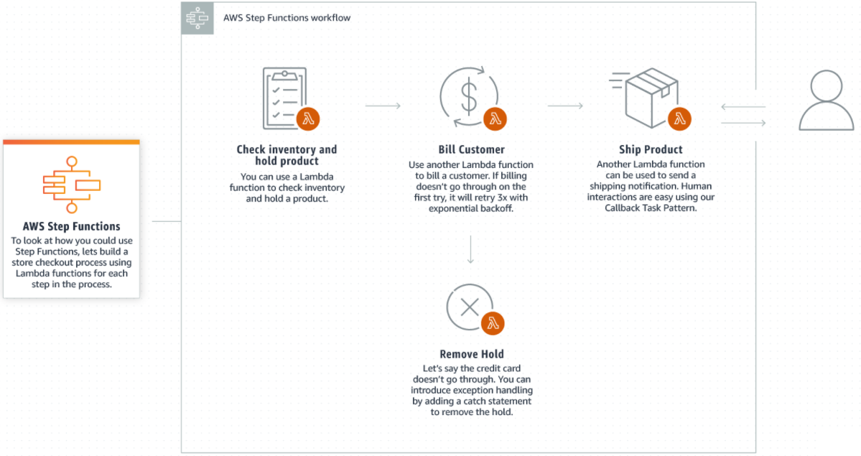
Step Functions Service
Build serverless visual workflow to orchestrate your Lambda functions
Integrate with AWS Services: EC2, ECS, On premise servers, API Gateway, Lambda, ...
Serverless Service
Tutorial: https://docs.aws.amazon.com/step-functions/latest/dg/welcome.html

Slide 4
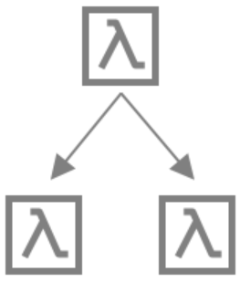
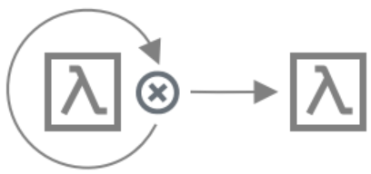
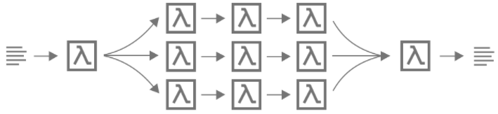

Step Functions Service
Features
Function orchestration
Branching
Error handling
(retry, catch)
Parallel processing

Slide 5
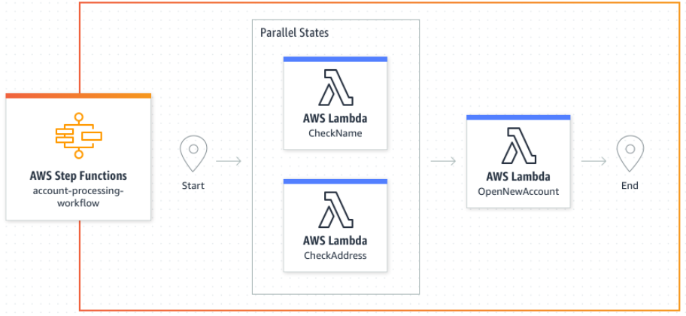
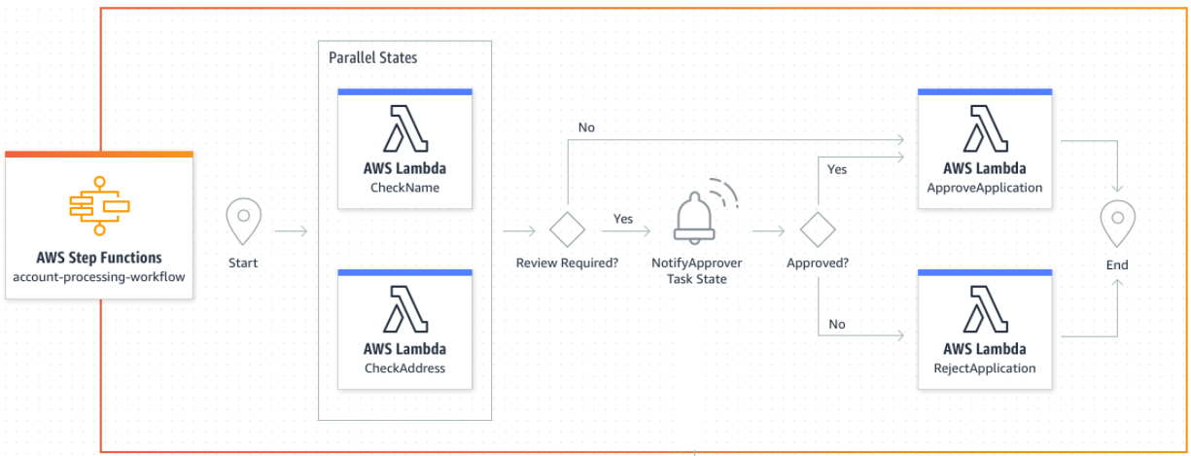
Step Functions Service
Usecases
Combine Lambda functions to build a web-based application
Build a web-based application - with a human approval
Microservice Orchestration

Slide 6
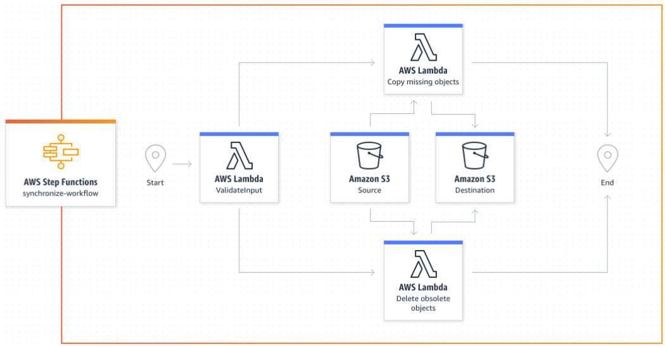
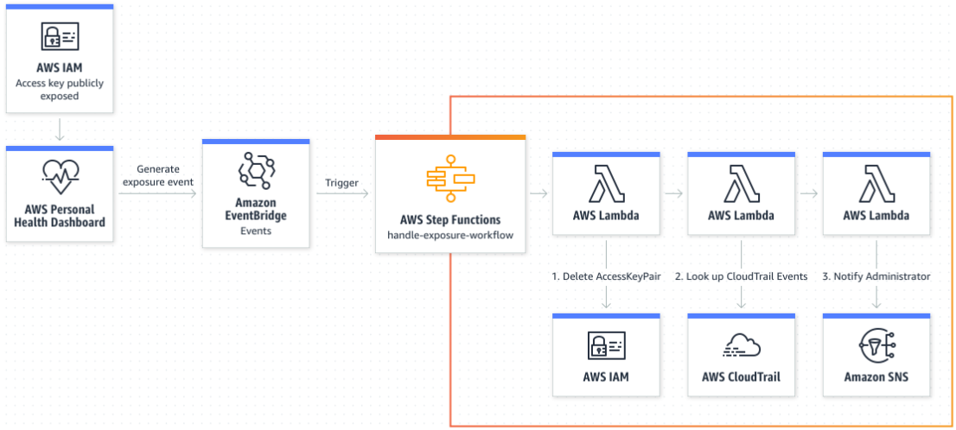
Step Functions Service
Respond to operational events in your AWS account
Synchronize data between source and destination S3 buckets
Security and IT Automation

Slide 7
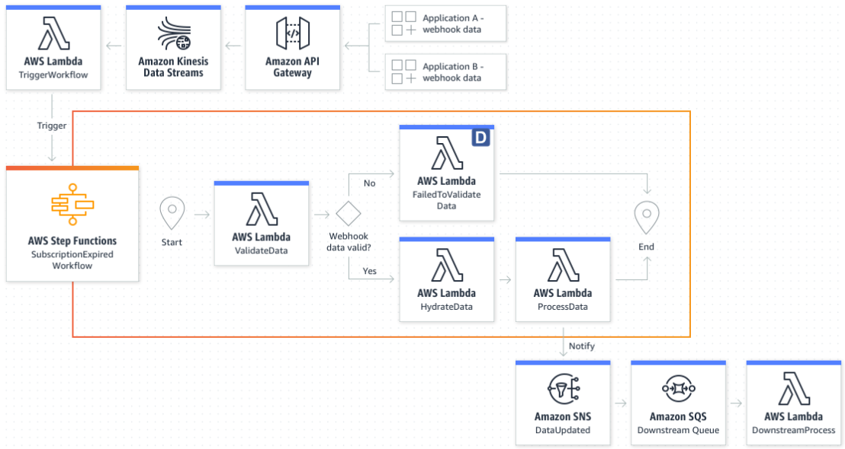
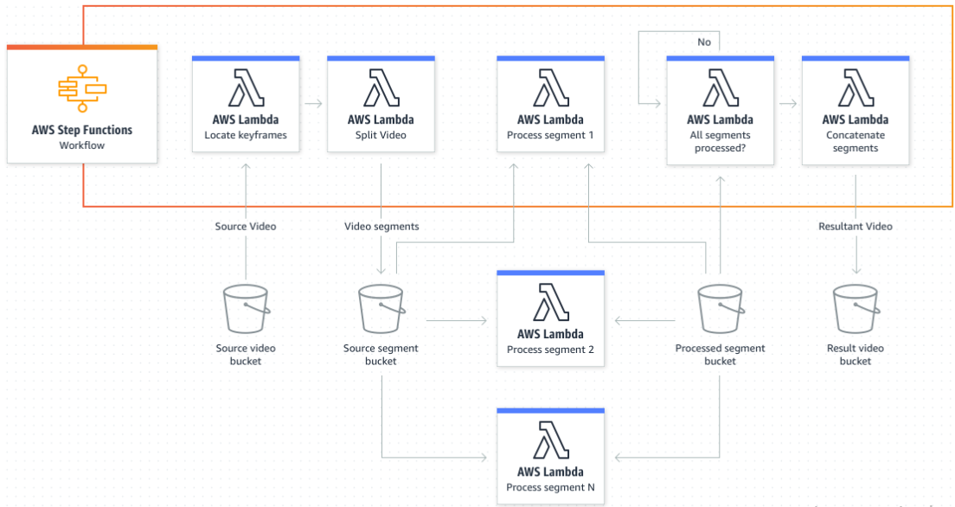
Step Functions Service
Build a data processing pipeline for streaming data
Split and transcode video using massive parallelization
Data Processing and ETL Orchestration

Slide 8
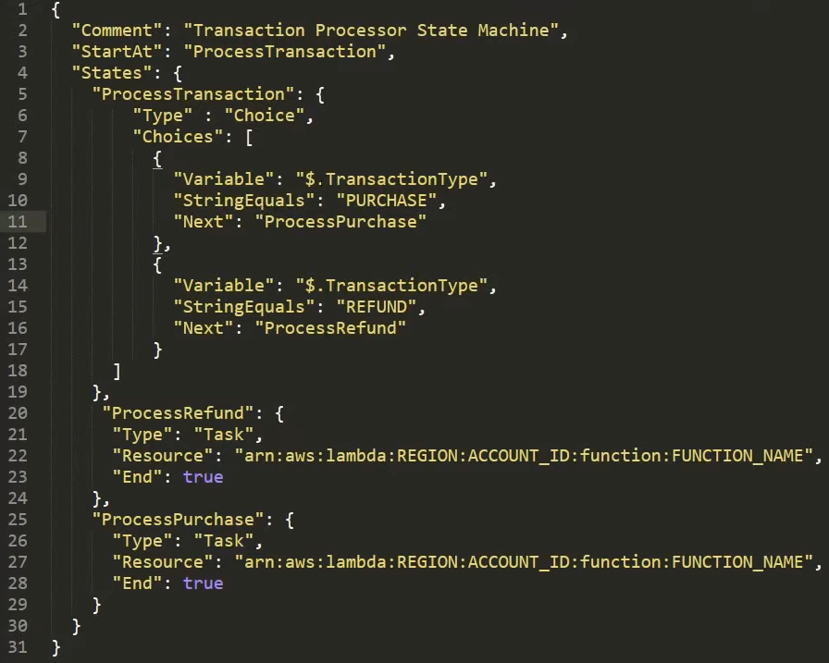
Step Functions Service
Demo
  https://www.youtube.com/watch?v=s0XFX3WHg0w
  https://www.youtube.com/watch?v=YHqRwPkhwLs
  https://www.youtube.com/watch?v=65MK5KqaVh4
Represent flow as a JSON state machine
Tutorial

Slide 9
Assignment
  Self-practice

Slide 10
Simple Workflow Service
Similar to Step Functions Service
Code runs on EC2 (not serverless)
Step Functions is recommended to be used for new applications, except:
  If you need external signals to intervene in the processes
  If you need child processes that return values to parent processes
Demo
  https://www.youtube.com/watch?v=Z_dvXy4AVEE
  https://www.youtube.com/watch?v=7lFVAGR57Z8

Slide 11
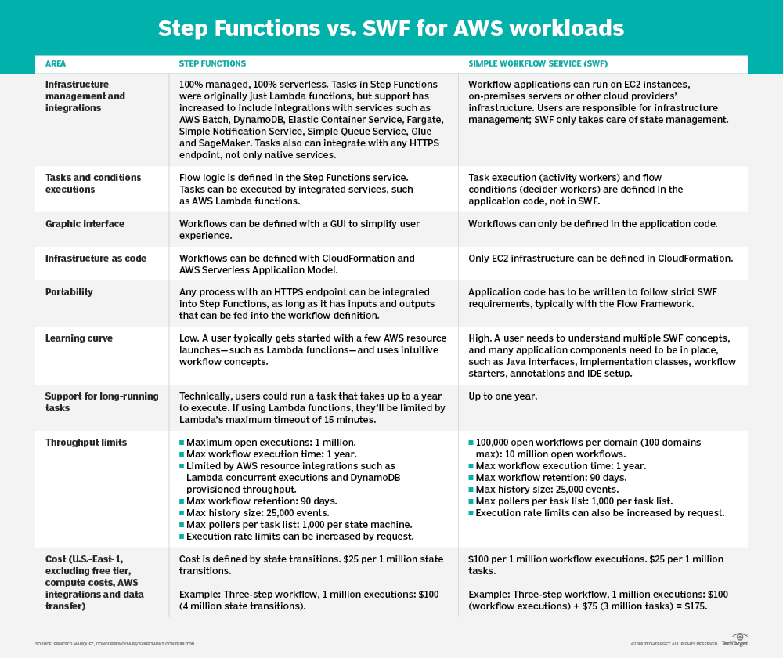
Simple Workflow Service
Compare: https://www.techtarget.com/searchaws/tip/Step-Functions-outshines-SWF-for-most-AWS-workflows

Slide 12
Q & A
Copyright © VTI Academy All Rights Reserved

